Slide 1

Helping users navigate data specifications
Data specification navigator
Quoc Anh Nguyen
Supervisor: doc. Mgr. Martin Nečaský, Ph.D.

Slide 2
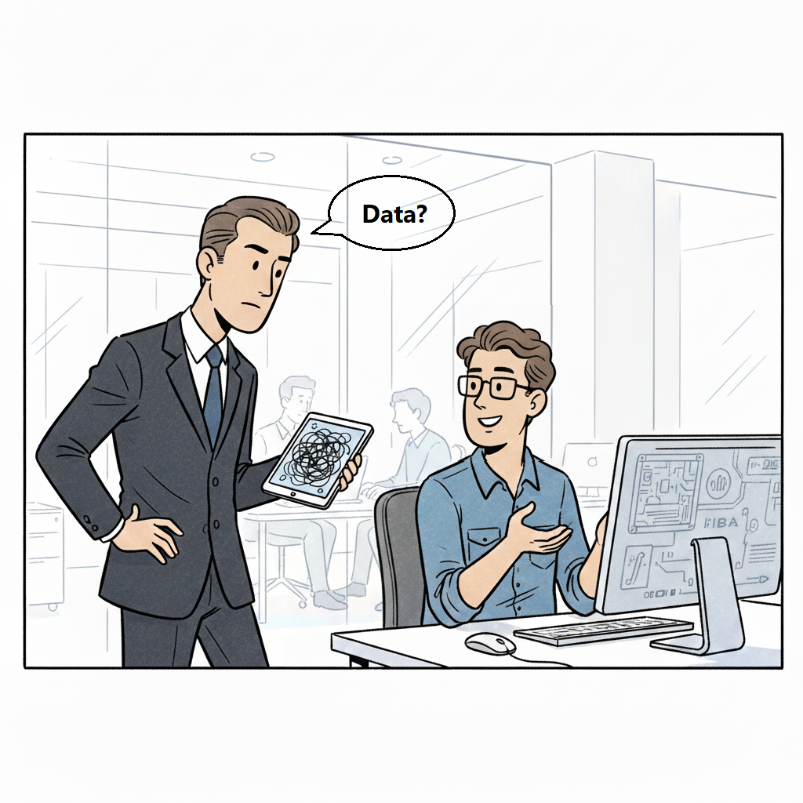

Slide 3
Motivation – the problem
Users want data but don’t know SPARQL or the domain very well.
They rely on a human expert.
This creates a bottleneck in organizations.

Slide 4
Goals
Map natural-language questions to items in data specification with the help of LLM.
Generates SPARQL queries.
Suggest related items to refine queries with the help of LLM.

Slide 5
Dataspecer
Ongoing project at KSI.
Tool for management of semantic data specifications.

Slide 6
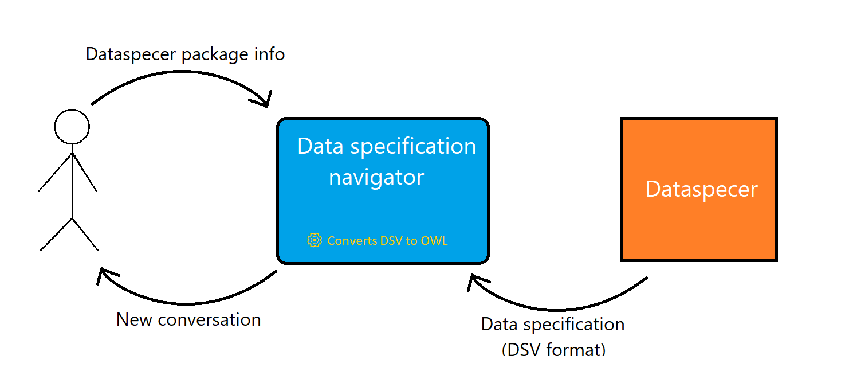
Input and output

Slide 7
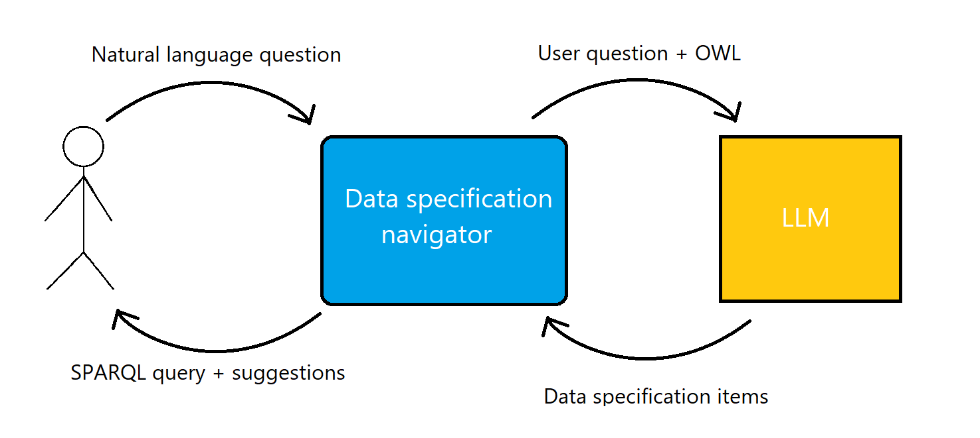
Input and output cont.

Slide 8









Frontend
User input
Chatbot replies
SPARQL queries
Conversation
service
Data
specification
service
SPARQL
translation
Processed responses
LLM connector
Dataspecer connector
DSV format
Dataspecer
Prompt responses
Data specifications

Slide 9


Technologies

Slide 10
Showcase (screenshots)

Slide 11
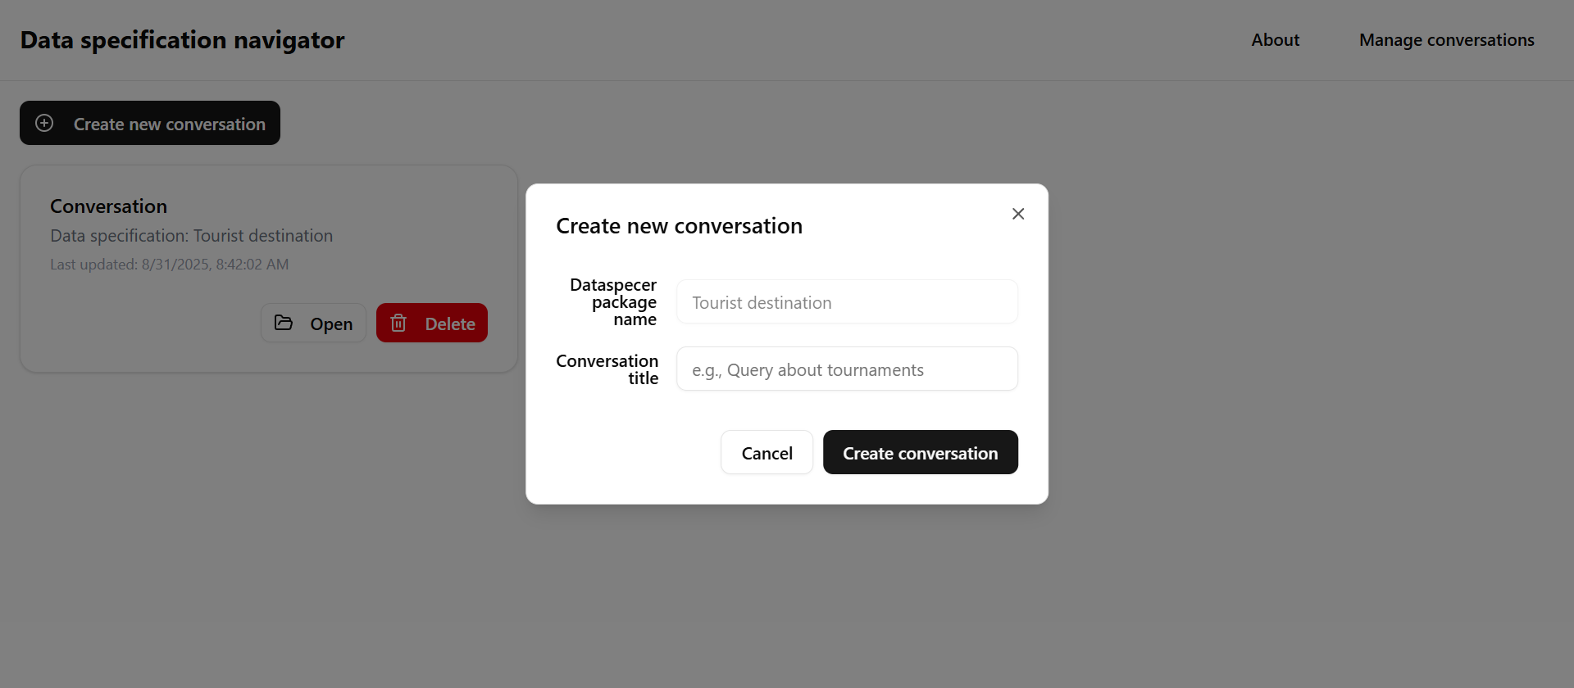

Slide 12

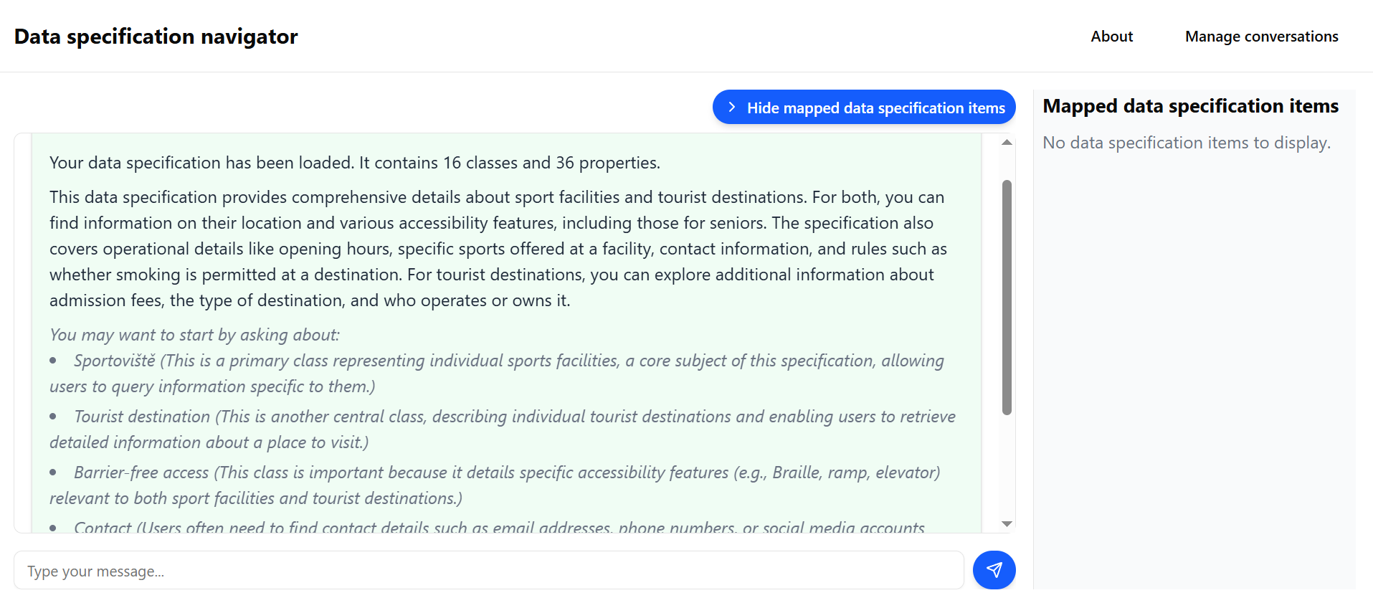

Slide 13
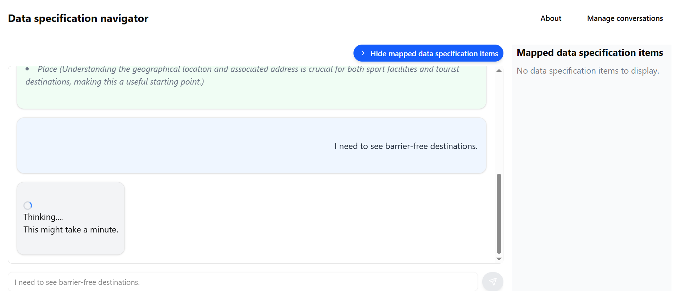

Slide 14
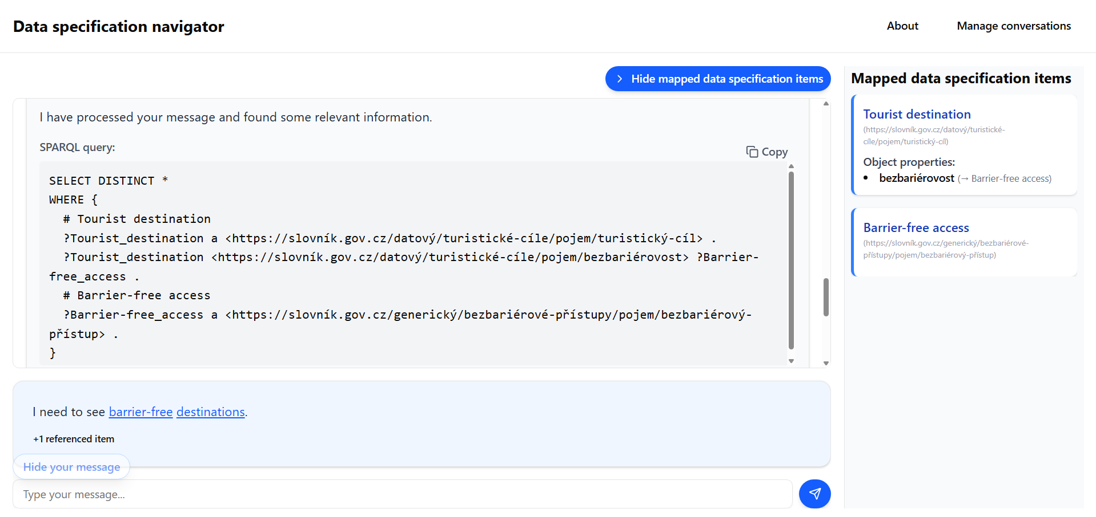

Slide 15
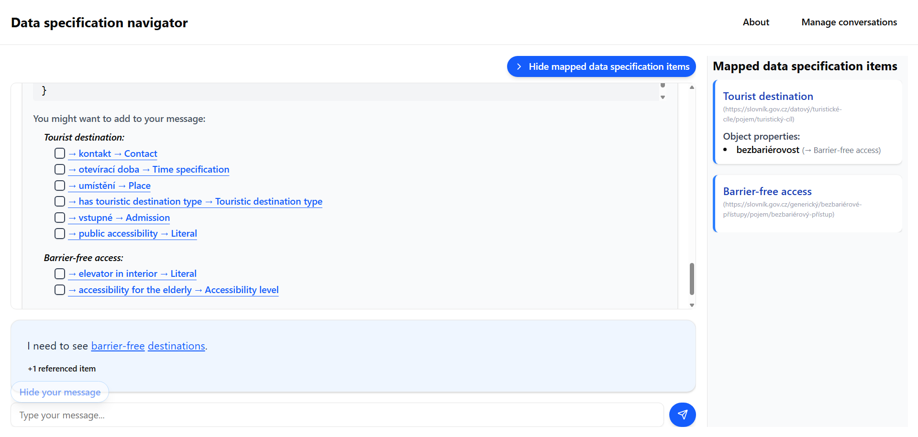

Slide 16
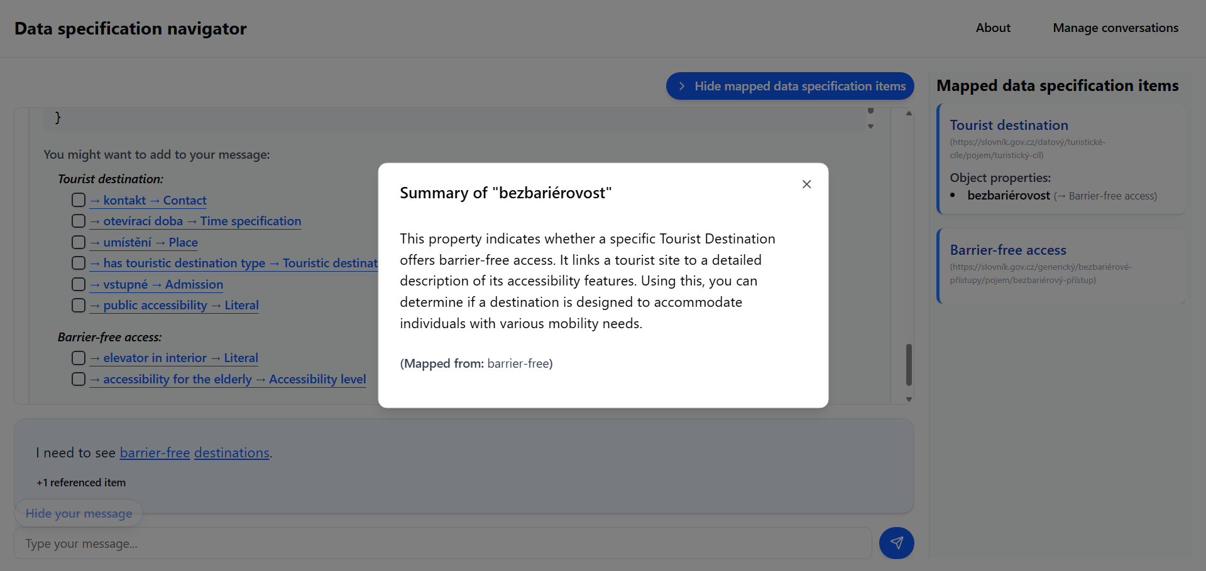

Slide 18
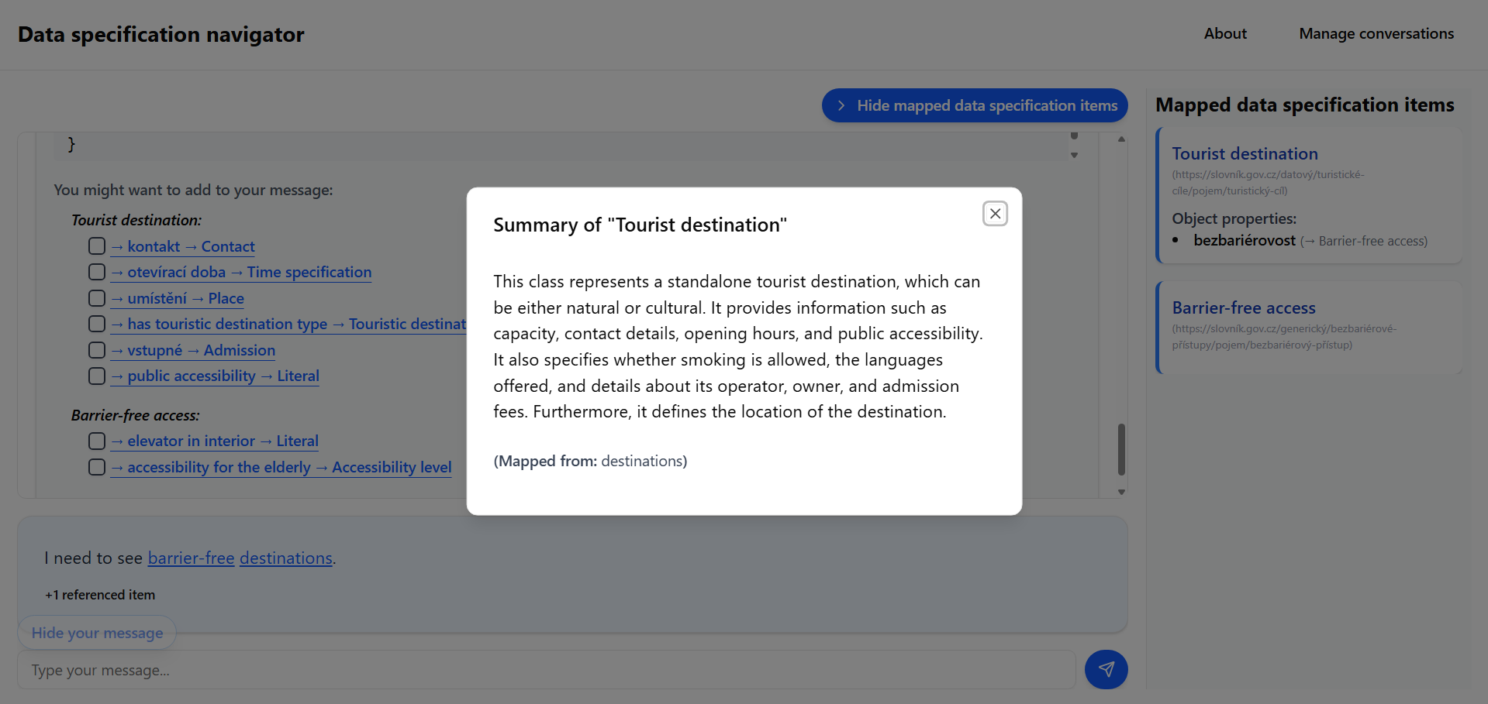

Slide 20
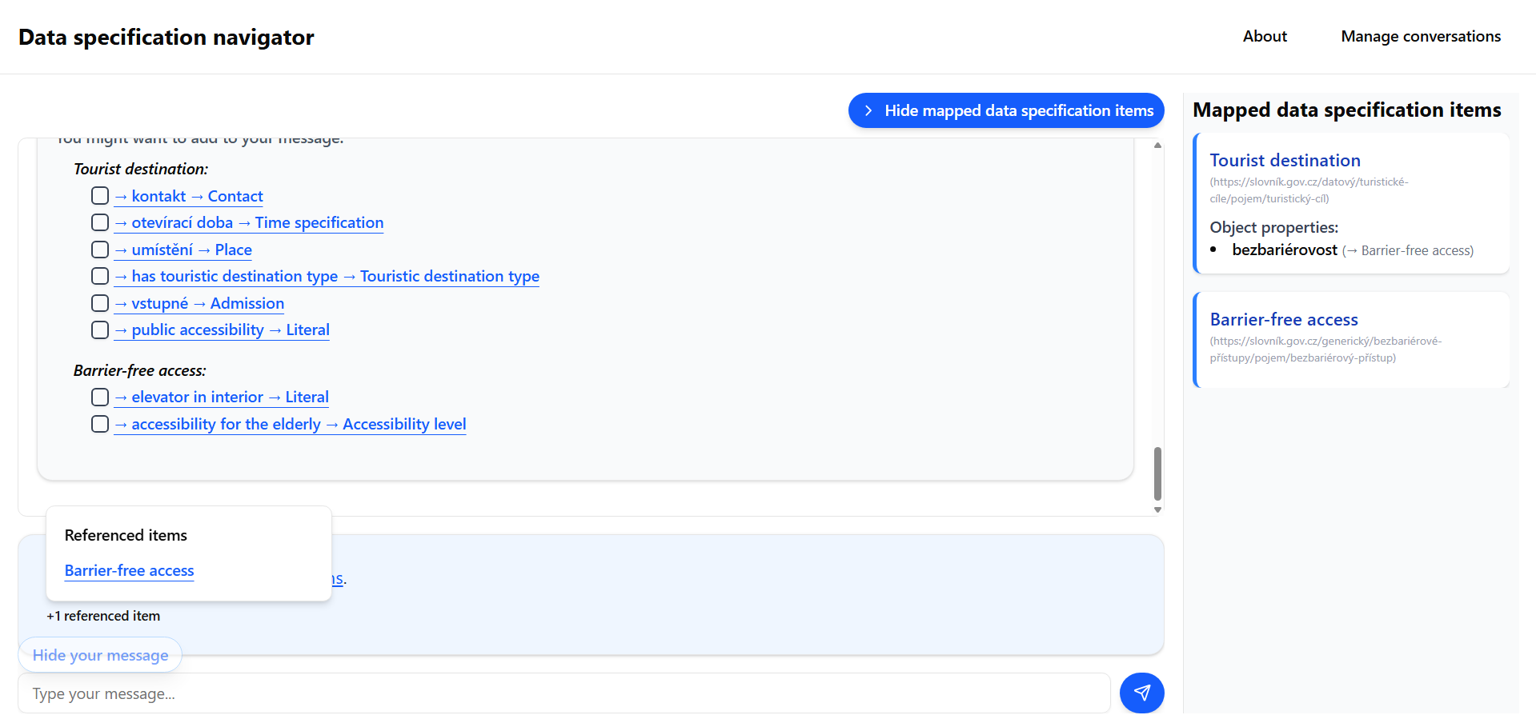

Slide 21
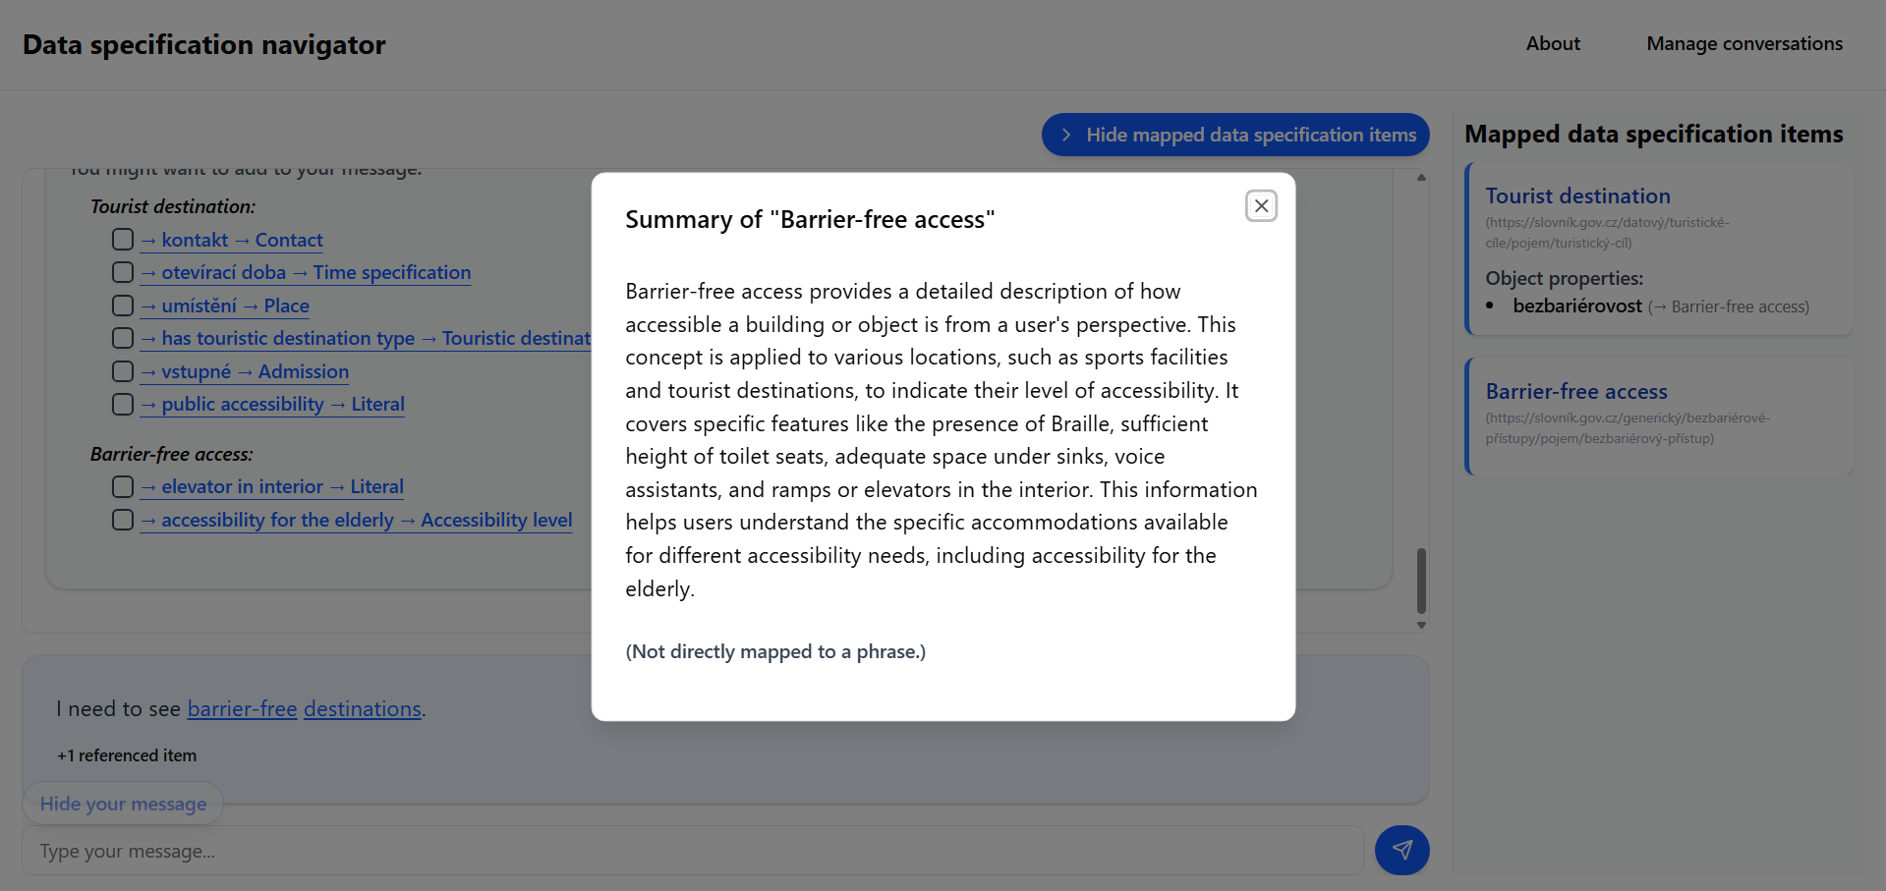

Slide 22
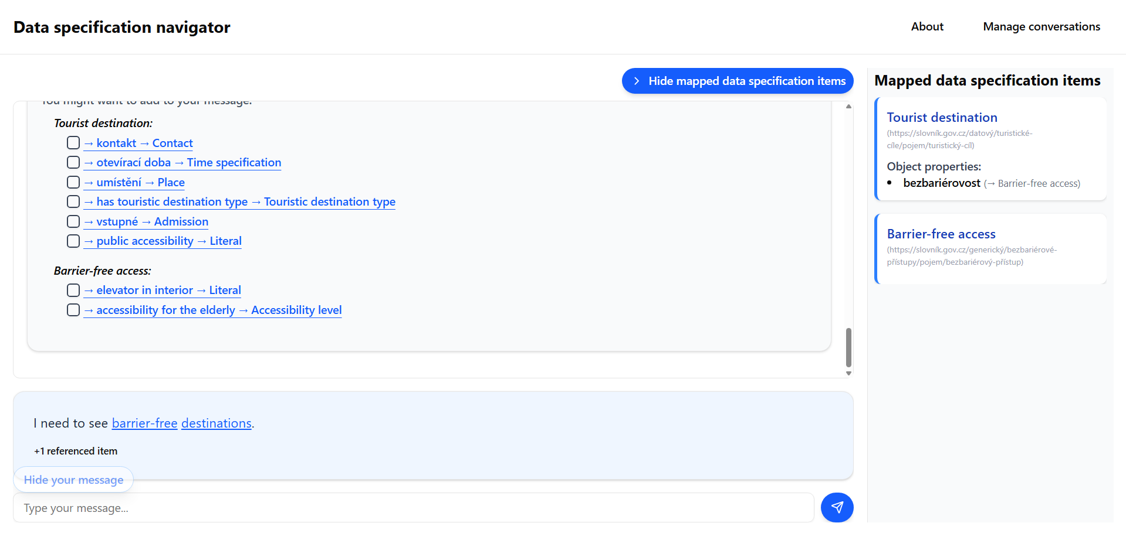

Slide 23
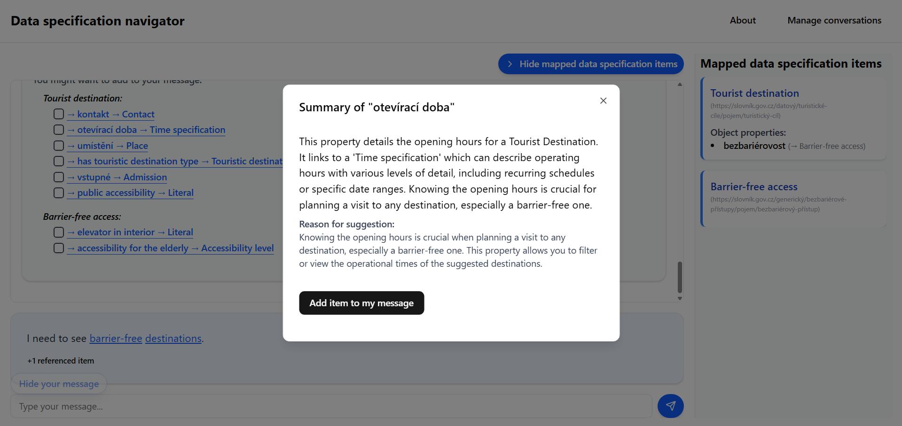

Slide 25
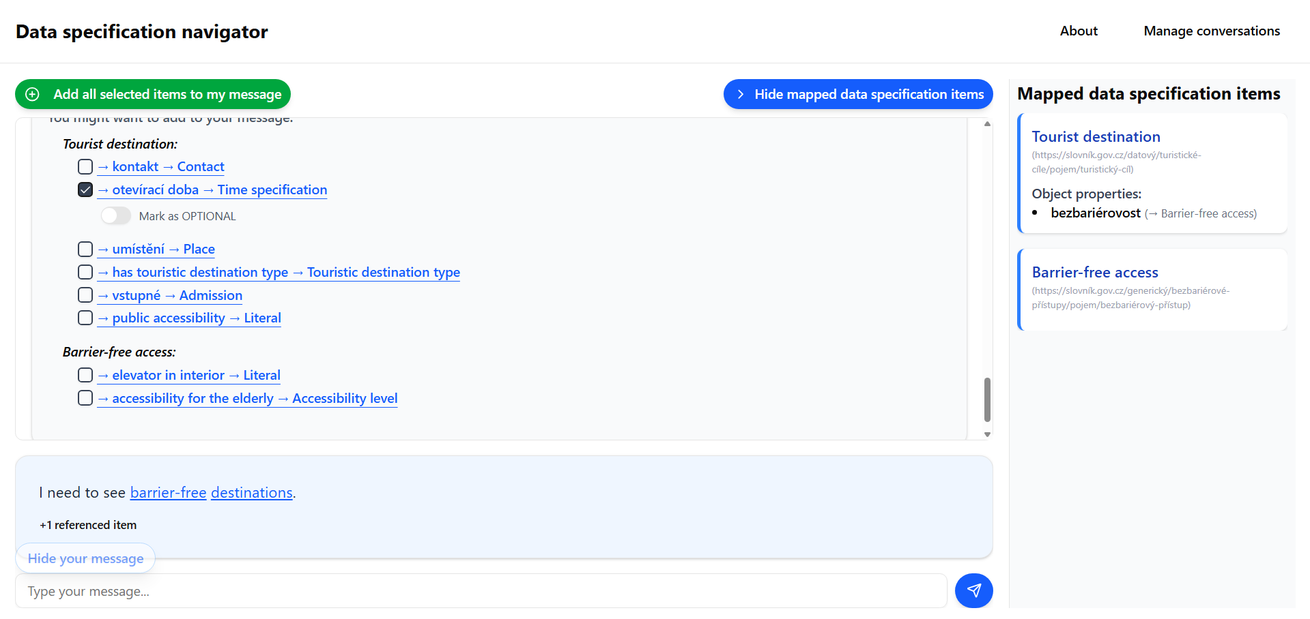

Slide 26


Slide 27
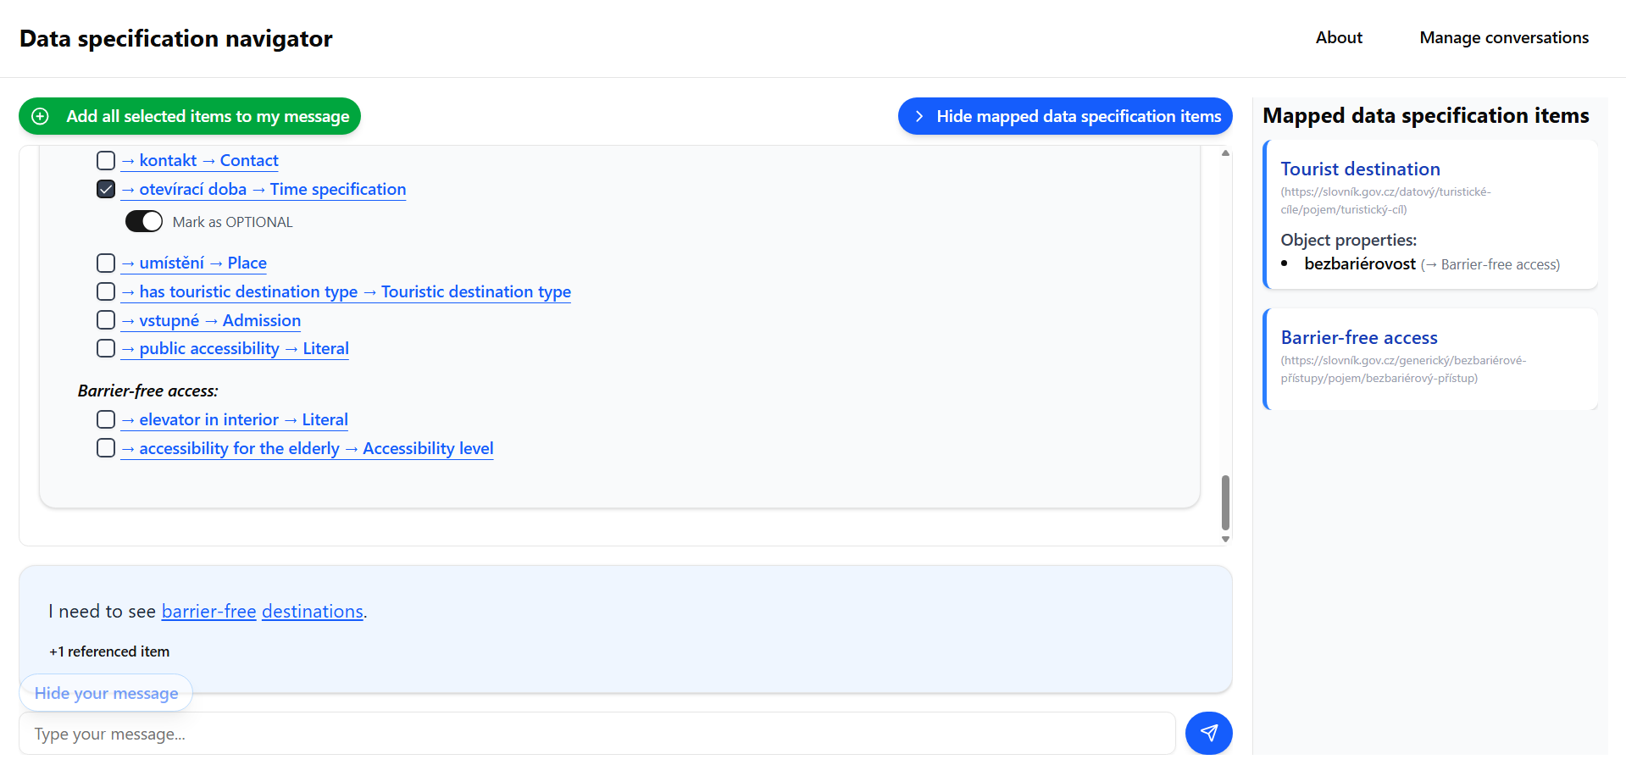

Slide 28
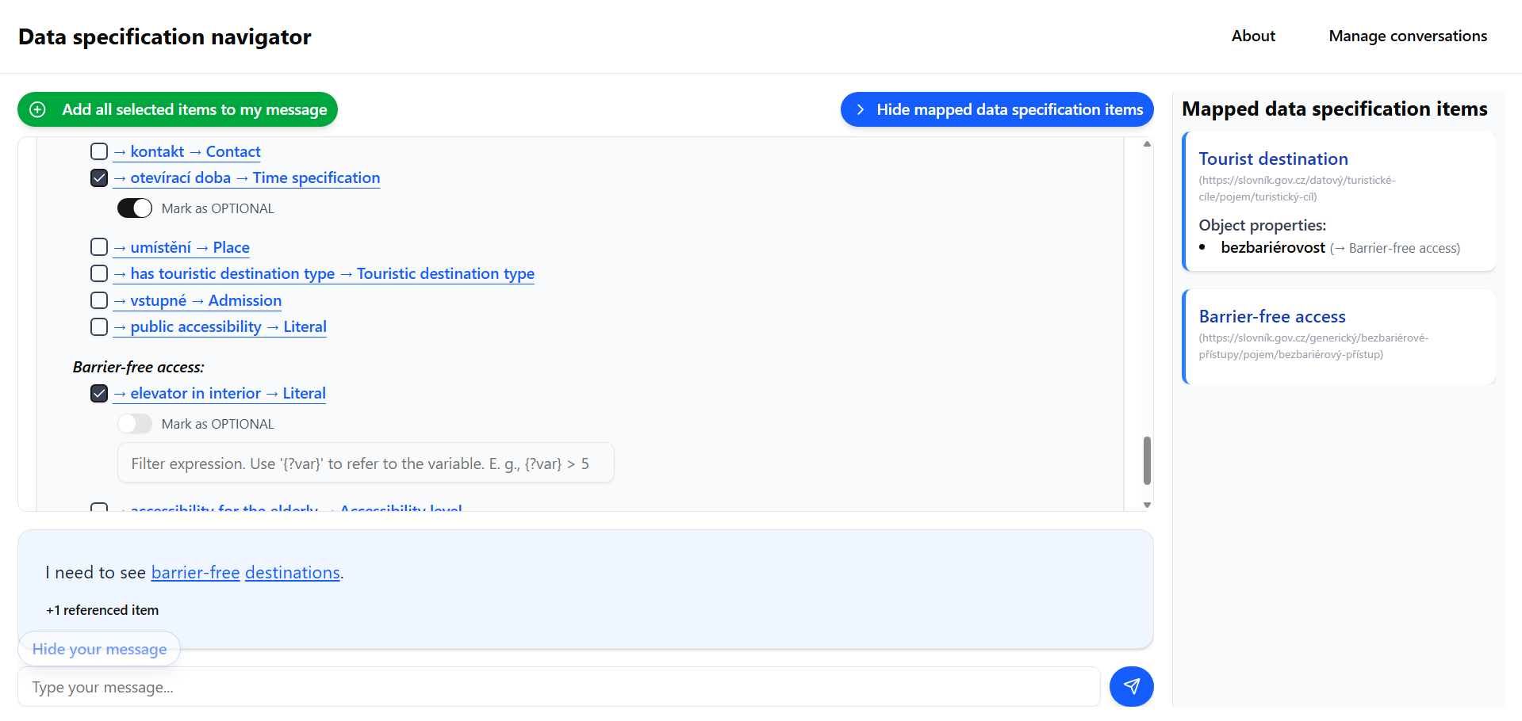

Slide 29
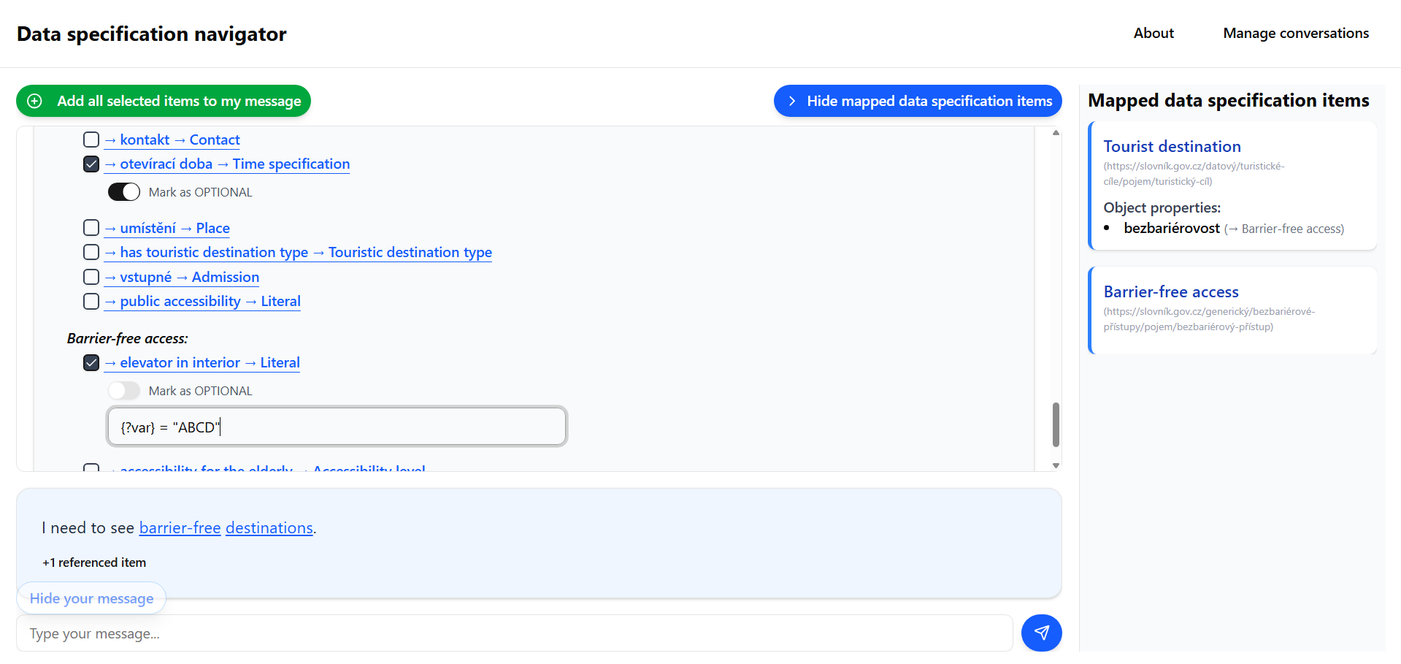

Slide 30
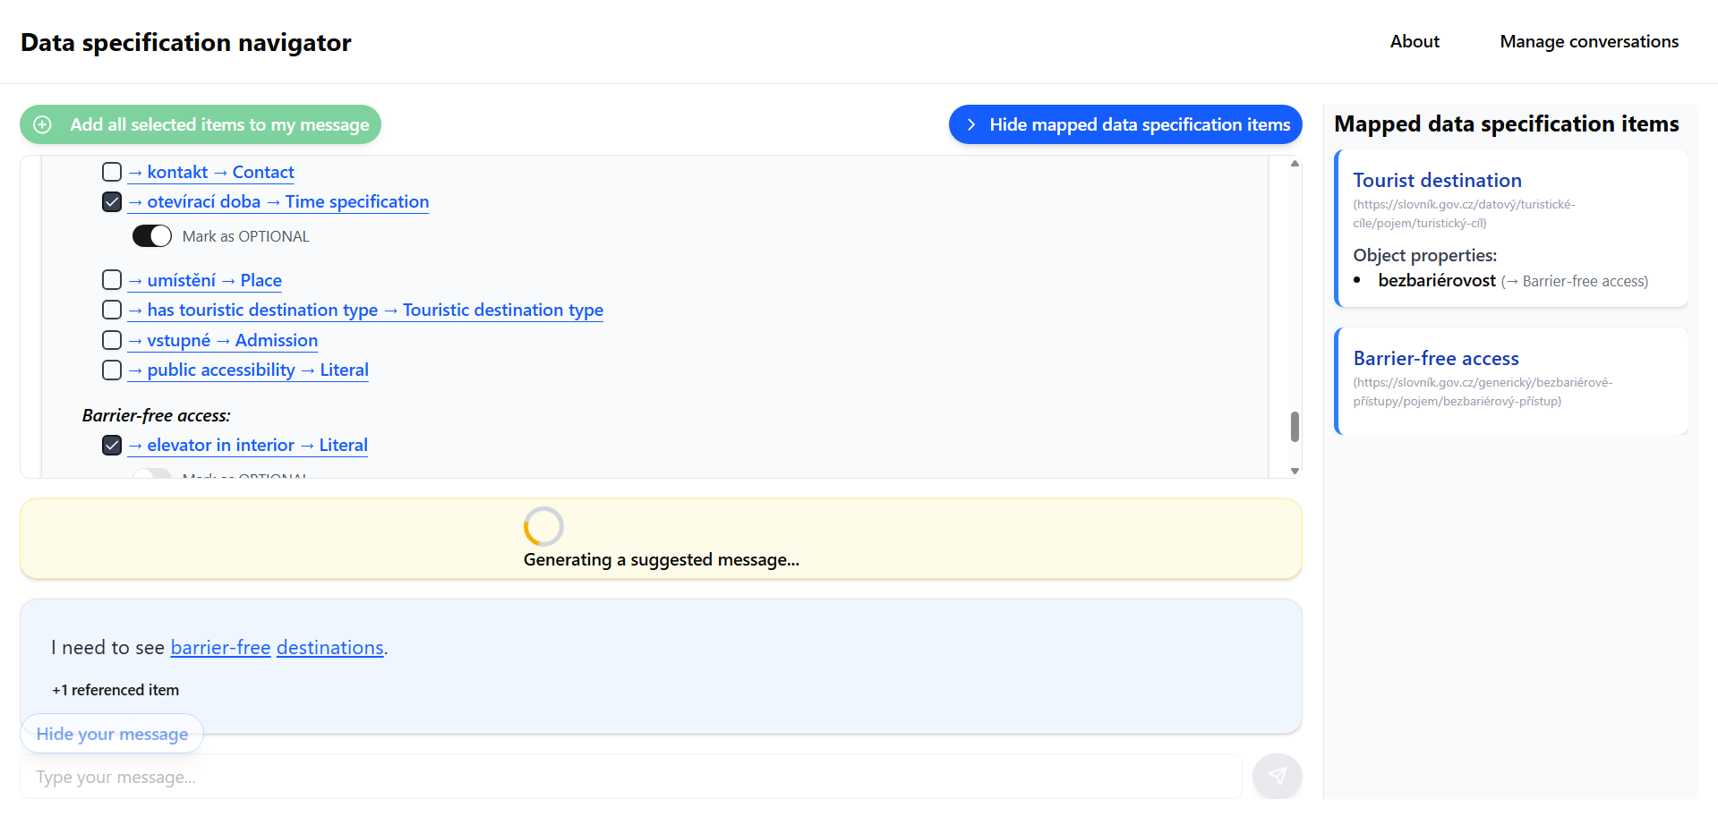

Slide 31
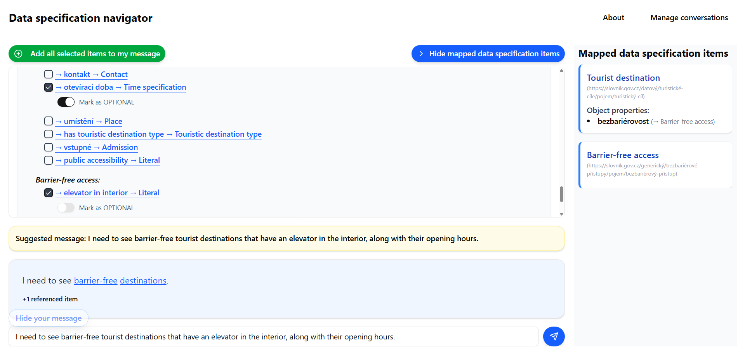

Slide 32
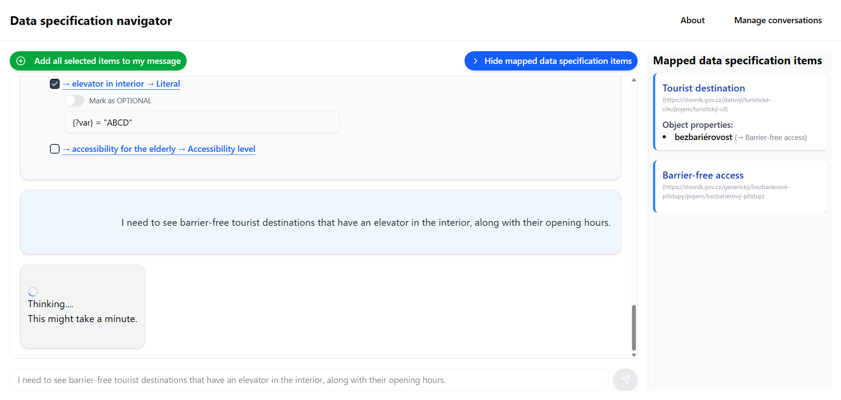

Slide 33
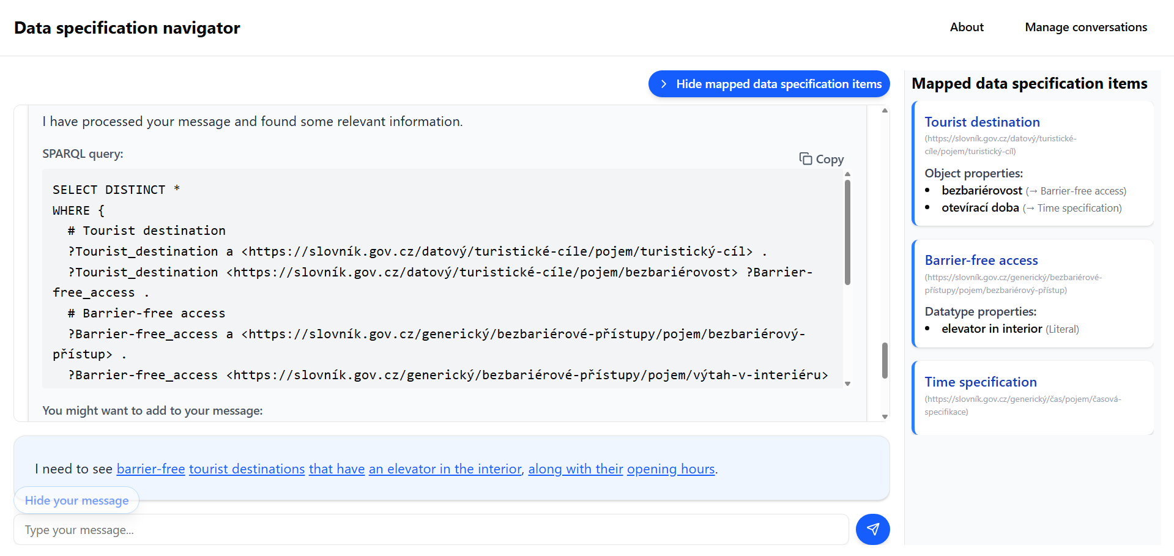

Slide 34
SELECT DISTINCT *
WHERE {
# Tourist destination
?Tourist_destination a <https://slovník.gov.cz/datový/turistické-cíle/pojem/turistický-cíl> .
?Tourist_destination <https://slovník.gov.cz/datový/turistické-cíle/pojem/bezbariérovost> ?Barrier-free_access .
# Barrier-free access
?Barrier-free_access a <https://slovník.gov.cz/generický/bezbariérové-přístupy/pojem/bezbariérový-přístup> .
?Barrier-free_access <https://slovník.gov.cz/generický/bezbariérové-přístupy/pojem/výtah-v-interiéru> ?elevator_in_interior .
FILTER(?elevator_in_interior = "ABCD")
OPTIONAL {
?Tourist_destination <https://slovník.gov.cz/datový/turistické-cíle/pojem/otevírací-doba> ?Time_specification .
# Time specification
?Time_specification a <https://slovník.gov.cz/generický/čas/pojem/časová-specifikace> .
}
}

Slide 35
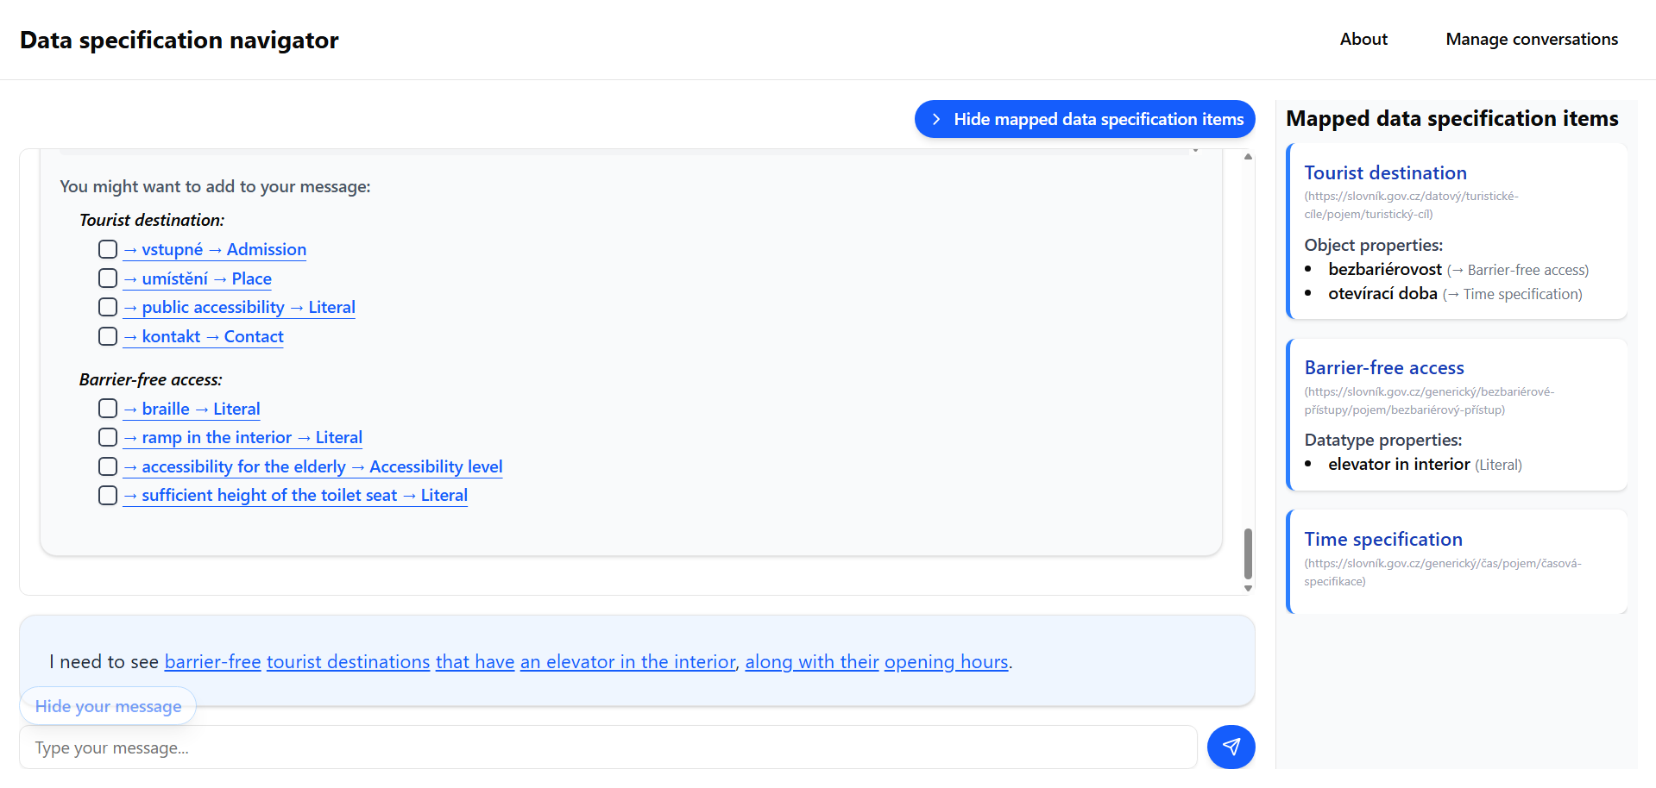

Slide 37
Successfully implemented
DSV to OWL conversion.
Mapping concepts from natural language to data specifications.
SPARQL generation.
Suggestions for natural-language question.
Foundation for future extension and research.

Slide 38
